Slide 1
Uniform Information

Slide 2
Contents
General Instructions
Orchestra Group Uniform Pictures and Descriptions
Tuxedo pants and jackets Fitting and Care
Long Skirt Fitting and Care (Concert & Chamber Orchestras)
Tie and Cummerbund Fitting and Care
Tuxedo Shirts
Long Dress Fitting and Care (Sinfonia & Symphonic Strings)
Short Dress Fitting and Care (Starlight Serenade)
Garment Bags
Tips to Look Your Best and End of Year Instructions

Slide 3
General Instructions
Students should try on their uniform as soon as they bring it home. We try to fit students as best we can, but the garment length may need to be adjusted to fit. If an adjustment is needed please do so as soon as possible so they will be ready for the first performance of the year.
Read through these slides for uniform fitting and care instructions
Students are responsible for cleaning and maintaining their uniforms through the year. Please ensure they are always clean and in good condition for performances.
If there is an issue or problem with the uniform please contact Shannon Payne at 602-751-0956. For questions about the uniform payment please contact the Highland Orchestra Treasurer at highlandorchestratreasurer@gmail.com.

Slide 4
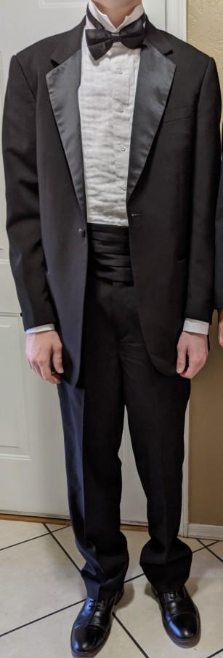
Orchestra Group Uniform Descriptions
All male students wear tuxedo pants and jackets with tie and cummerbund (school rental).
Each student purchases and owns his own Wing Collar Tuxedo Shirt and supplies his own black dress shoes and long black dress socks.

Slide 5
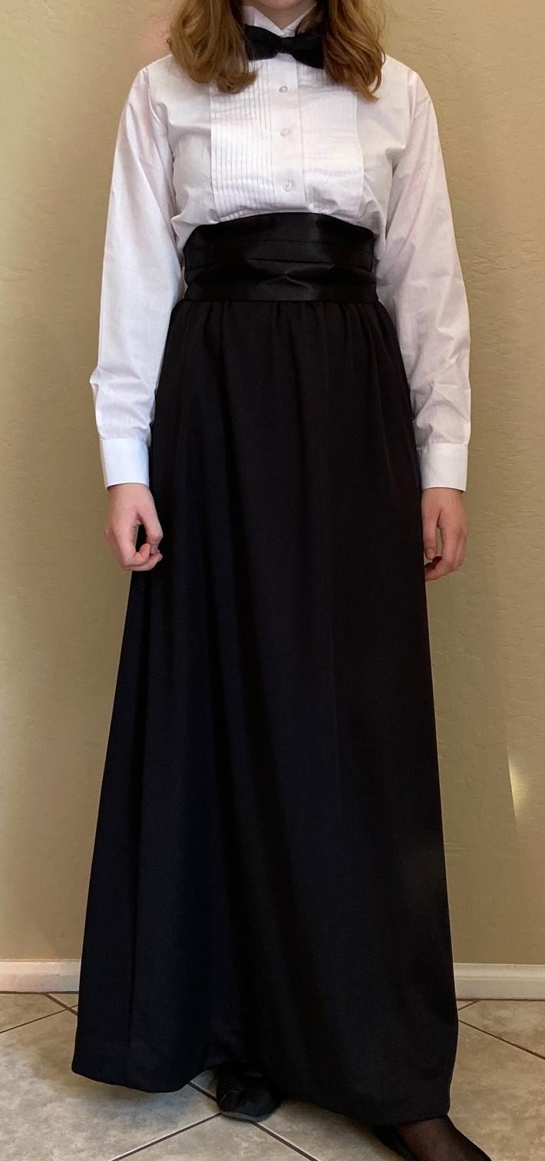
Orchestra Group Uniform Descriptions (continued)
Female students in Concert and Chamber Orchestras wear long black skirts with tie and cummerbund (school rental).
Each student purchases and owns her Wing Collar Tuxedo Shirt and supplies her own dress slip, closed-toe black dress shoes (no boots) and sheer black nylons. Tuxedo shirts are sheer, so plan on wearing a white tank top or undershirt beneath.

Slide 6
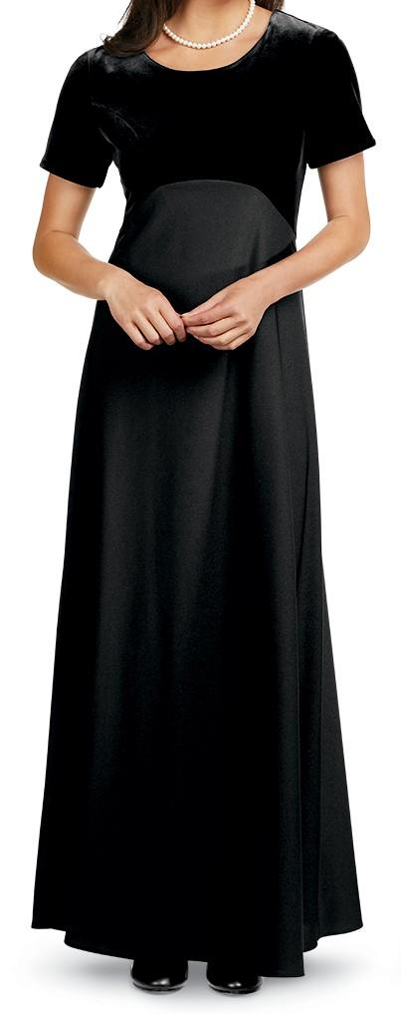
Orchestra Group Uniform Descriptions (continued)
Female students in Sinfonia and Symphonic Strings wear long black dresses which each student purchases through the school.
Each student owns and keeps her dress, and supplies the dress slip, closed-toe black dress shoes (no boots) and sheer black nylons.

Slide 7
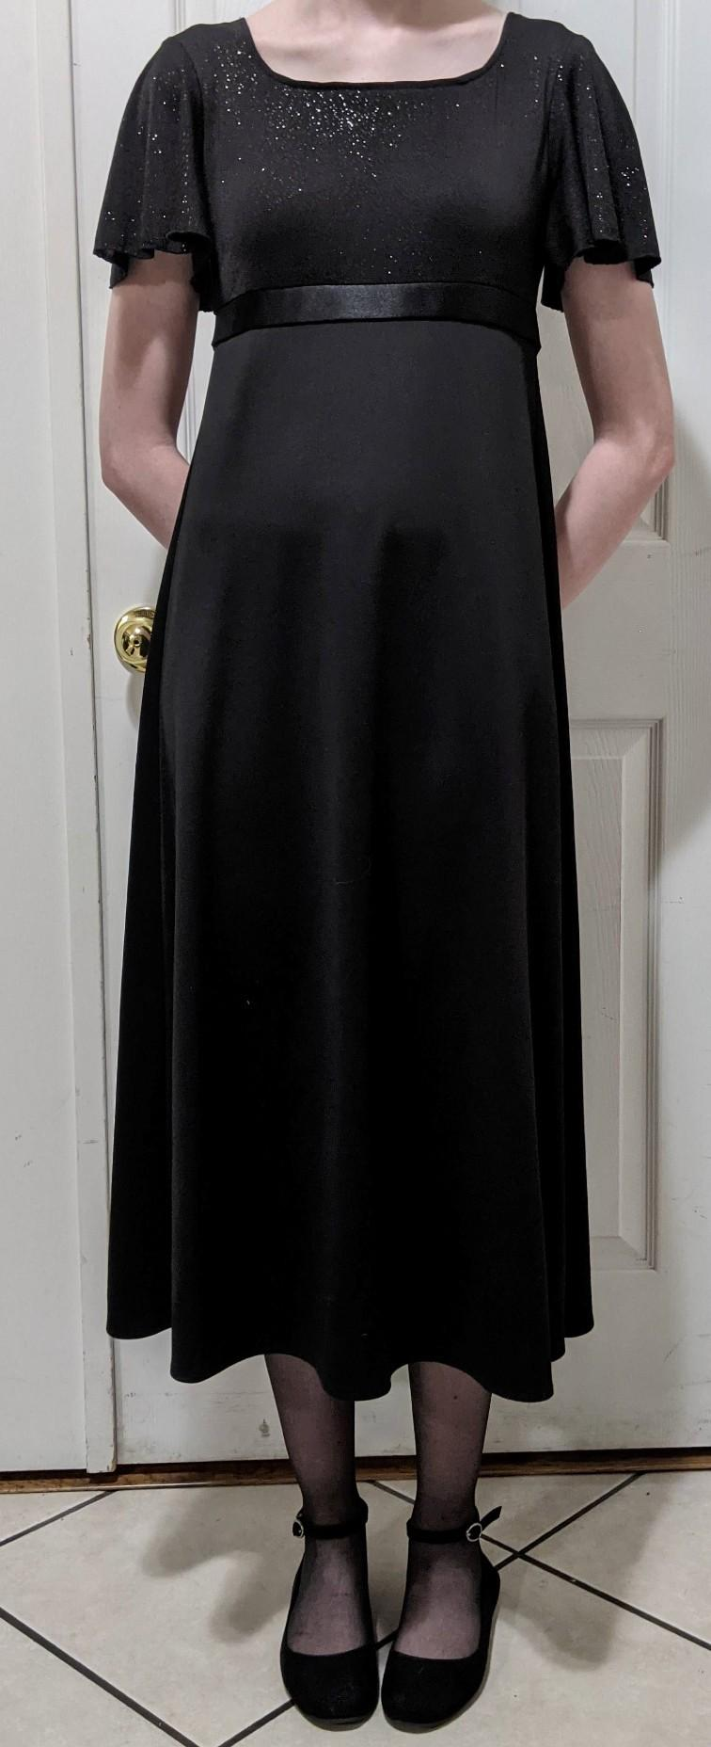
Orchestra Group Uniform Descriptions (continued)
Female students in Starlight Serenade (Strolling Strings) wear shorter black dresses (school rental).
Each student supplies her own dress slip, closed-toe black dress shoes (no boots) and sheer black nylons.

Slide 8
Tuxedo pants and jackets Fitting and Care
Jackets:
Tux jackets should not need to be altered
If a button comes loose or falls off please sew it back on How to Sew a Shank Button video link (extra buttons are available)
Pants:
The length may need to be hemmed shorter, or the length let down. The bottom of the pant leg in the back should touch the top of the heel of the performance shoe.
Do not cut any fabric length off the pants when hemming
To hem, use a sewing machine with a blind stitch How to Hem Pants using a Blind Stitch video link, or sew by hand How to Hem Pants by Hand video link
Do not use any kind of fabric glue or tape to hem
Cleaning and Care:
Jackets and pants can be spot cleaned with a damp cloth, and should be dry cleaned when they become dirty or smelly. Keep pants and jackets hung up to avoid wrinkles.
How to Hang Up Tux Pants Properly video link

Slide 9
Long Skirt Fitting and Care (Concert/Chamber)
The length of the skirt may need to be hemmed shorter, or the length let down. The bottom of the skirt should be 1 inch from the floor when the performance shoes are worn.
Do not cut any fabric length off the skirt when hemming
Because the fabric is stretchy, hemming by hand is best How to Hem a Skirt by Hand video link
Do not use any kind of fabric glue or tape to hem
Cleaning and Care:
Skirts may be machine washed in cold water on a Delicate/Gentle Cycle and laid flat to dry. Hang up to avoid wrinkles.

Slide 10
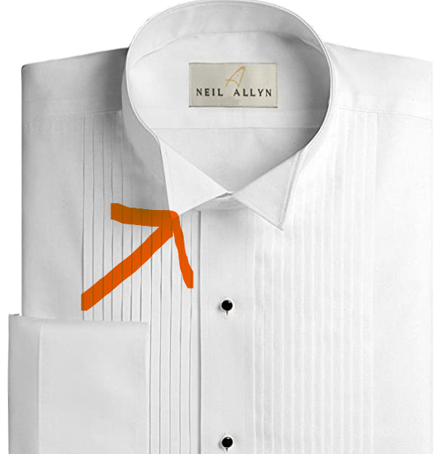
Tuxedo Shirts (all males, plus females in Concert and Chamber)
Wing Collar Tuxedo Shirts are required, and purchased by each student
¼ inch Pleats
White buttons (remove black studs)
Available in men’s and women’s sizes
Purchase from any formal wear shop in the area (The Tuxedo Lady, Men’s Wearhouse, Department Stores), or online (Amazon, Formal Fashions)

Slide 11
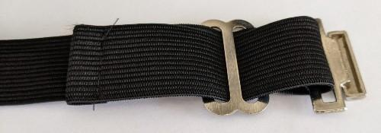
Tie and Cummerbund Fitting and Care
Tie
Slide the bow tie under the loop on the back of the wing collar tuxedo shirt to keep it in place
Tuck the wing tips of the shirt collar beneath the bow tie
Cummerbund
Wear the cummerbund with the pleats facing out and pointing up, over the waistband of the pants or skirt
Do not tie the elastic in knots to adjust the length or to fasten
The length can be adjusted. If it is still too long after adjusting, the elastic can be pinned, or the elastic can be reversed in the metal slide to allow for further adjusting

Slide 12
Long Dress Fitting and Care (Sinfonia/Symphonic Strings)
The length of the dress may need to be hemmed shorter. The bottom of the dress should be 1 inch from the floor when the performance shoes are worn.
Note: These dresses have been purchased by each student and can be altered permanently to fit each student (fabric can be cut)
Because the fabric is stretchy, hemming by hand is best How to Hem a Skirt by Hand video link
Do not use any kind of fabric glue or tape to hem
Cleaning and Care:
Dresses may be machine washed in cold water on a Delicate/Gentle Cycle and laid flat to dry. To avoid wrinkles, do not leave the dress in the garment bag with the bottom bunched up.

Slide 13
Short Dress Fitting and Care (Starlight Serenade)
Starlight Serenade dresses do not need to be hemmed unless the dress falls below mid-calf
If it does need to be hemmed, hemming by hand is best because of the stretchy fabric How to Hem a Skirt by Hand video link
Do not cut any fabric length off the skirt when hemming
Do not use any kind of fabric glue or tape to hem
Cleaning and Care:
These dresses should be dry cleaned, and hung up to avoid wrinkles

Slide 14
Garment Bags
Seniors receive a vinyl garment bag with Highland Orchestras logo. This is a gift and Seniors may keep this bag at the end of the year. Any students in Sinfonia or Symphony with long dresses also receive this vinyl bag, which is theirs to keep after graduation.
All other fabric (polypropylene) garment bags must be returned at the end of the school year with the uniform
Fabric garment bags may be machine washed in cold water on a Delicate/Gentle Cycle and hung to dry if they become dirty
Do not place shoes or heavy items in the garment bags

Slide 15
Tips to Look Your Best and End of Year Instructions
How to look your best:
Keep your uniform hung up between performances
How to Hang Up Tux Pants Properly video link
Spot clean your uniform, and dry clean (or wash if appropriate) when needed
Wash your tuxedo shirt regularly, and keep your dress shoes in good condition
Watch for runs or holes in sheer black nylons (keep an extra pair just in case)
Always wear a smile!
End of the Year Instructions:
All rented uniforms, fabric garment bags, hangers (wooden and plastic) must be returned. Check pockets and garment bags for personal belongings.
Uniforms do not need to be cleaned before this final return as they will be dry cleaned over the summer
Donated long dresses from graduating Seniors are gladly accepted

